Slide 1
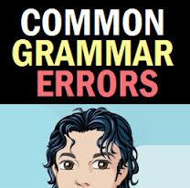
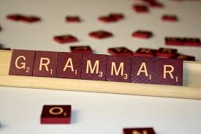
AND HOW TO CORRECT THEM
Courtesy of:
BELAGAN, CRISTINA A.
BSU MAEd Student

Slide 2
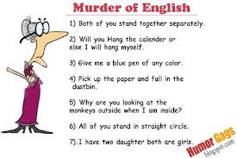
IGNORANCE OF GRAMMAR RULES MAKES ONE AN INSTANT COMEDIAN/COMEDIENNE.

Slide 3

1. The old man does not likes to be helped by his neighbour.
D
I
A
G
N
O
S
T
I
C
T
E
S
T
LIKE

Slide 4

DOUBLE PRESENT TENSE
THE HELPING VERB ALREADY TELLS THAT THE VERB IS SINGULAR.
1. The old man does not likes to be helped by his neighbour. (DOES NOT LIKE)
RULE:
DO/DOES/DID+BASE FORM OF THE VERB

Slide 5
2. The reporter was able to give the audience useful informations.
INFORMATION

Slide 6

THE USE OF PLURAL UNCOUNTABLE NOUNS
2. The reporter was able to give the audience useful informations. (INFORMATION)
RULE: UNCOUNTABLE NOUNS DO NOT TAKE THE ARTICLE A OR AN.
RULE: UNCOUNTABLE NOUNS DO NOT HAVE PLURAL FORMS.
She has (a) homework to do.

Slide 7
3. She
will be going to travel to Paris next month.
IS

Slide 8

THE USE OF THE TWO FORMS OF THE SIMPLE FUTURE TENSE AS ONE
VERB
3. She will be going to travel to Paris next month.
(IS GOING TO TRAVEL)
RULE: THE TWO FORMS OF THE FUTURE TENSE: WILL + BASE FORM (MV) AND BE GOING TO + BASE FORM (MV) SHOULD NOT BE USED TOGETHER.

Slide 9
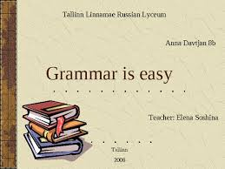
4. Did you told your parents what had happened?
TELL

Slide 10
DOUBLE PAST TENSE
4. Did you told your parents what had happened?
(DID TELL)
RULE: ALWAYS USE THE HELPING VERBS: DID/DOES/DO WITH THE BASE FORM OF THE MAIN VERB.

Slide 11

5.EACH STUDENTS WAS GIVEN SOMETHING TO DO.
STUDENT

Slide 12


THE USE OF PLURAL NOUNS AFTER EACH/EVERY/ONE
5. EACH STUDENTS WAS GIVEN SOMETHING TO DO.
(STUDENT)
RULE: EACH, EVERY, & ONE USED AS ADJECTIVES ARE ALWAYS FOLLOWED BY SINGULAR NOUNS.

Slide 13
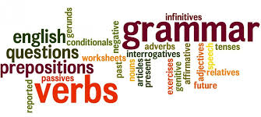
6. My friend and me prepared lunch for the visitors.
I

Slide 14



SUBJECTS
6. My friend and me prepared lunch for the visitors.
(FRIEND AND I)
THE USE OF OBJECTIVE PRONOUNS AS SUBJECTS
RULE: ONLY NOMINATIVE PRONOUNS SUCH AS HE/SHE/THEY/WE ARE USED AS SUBJECTS IN SENTENCES.
OBJECTIVE PRONOUNS SUCH AS HIM/HER/THEM/US ARE ALWAYS USED AS OBJECTS IN SENTENCES.

Slide 15
7. The reason for her silence was because she could not understand you.
THAT

Slide 16



RULE: NEVER USE REDUNDANT EXPRESSIONS.
EXAMPLES: LIKE FOR EXAMPLE;
FOR ME, I THINK;BUT HOWEVER
7. The reason for her silence was because she could not understand you.
(THAT)
THE USE OF REDUNDANT EXPRESSIONS

Slide 17
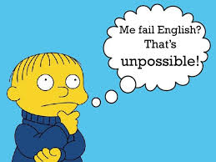
MY BROTHER AND I
8. I and my brother used to quarrel when we were young .

Slide 18

THE INCORRECT PLACEMENT OF THE PRONOUN I IN A COMPOUND SUBJECT
COMPOUND SUBJECT
8. I and my brother used to quarrel when we were young.
(MY BROTHER AND I)
RULE: THE PRONOUN I USED AS A PART OF A COMPOUND SUBJECT SHOULD NEVER COME FIRST.

Slide 19
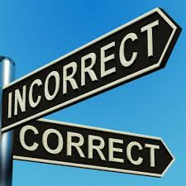
9. Everyone needs to show their signed permit before the start of the show .
HIS/HER

Slide 20

RULE: SINGULAR INDEFINITE PRONOUNS (EVERYBODY, ANYONE, SOMEONE, ANYBODY, EACH) SHOULD BE USED WITH SINGULAR PERSONAL PRONOUNS (HE, SHE, IT).
SINGULAR INDEFINITE
PRONOUN
9. Everyone needs to show their signed permit before the start of the show.
(HIS/HER)
THE USE OF PLURAL PERSONAL PRONOUNS TO REFER TO SINGULAR INDEFINITE PRONOUNS
PLURAL PERSONAL PRONOUN

Slide 21
10. We go to London when I was fourteen years old.
WENT

Slide 22



THE INCORRECT USE OF VERB TENSES
10. We go to London when I was 14 years old.
(WENT)
RULE: USE PAST TENSES TO TALK ABOUT EVENTS IN THE PAST, FUTURE TENSES IN THE FUTURE, AND PRESENT TENSES IN THE PRESENT.
EXAMPLE: I PLAYED SOCCER LAST WEEK. I ALWAYS PLAY SOCCER ON WEEKENDS. I WILL PLAY SOCCER TOMORROW.

Slide 23

11. One of the players are injured.
IS

Slide 24
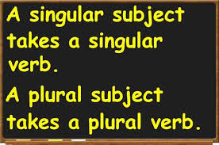

RULE:
SINGULAR SUBJECT
PLURAL SUBJECT
11. One of the players are injured.
(IS)
INCORRECT SUBJECT-VERB AGREEMENT

Slide 25
12. Edgar’s speech is more better than your speech.
BETTER

Slide 26


RULE: A COMPARATIVE ADJECTIVE/ADVERB SHOULD NOT BE PRECEDED BY MORE.
A SUPERLATIVE ADJECTIVE/ADVERB SHOULD NOT BE PRECEDED BY MOST.
EXAMPLES: MORE FASTER
MOST FASTEST
12. Edgar’s speech is more better than your speech.
(BETTER)
DOUBLE COMPARATIVES

Slide 27

13. My friend’s house is farther than me.
MINE

Slide 28
ILLOGICAL/UNBALANCED COMPARISON
13. My friend’s house is farther than me.
(MINE/MY HOUSE)
RULE: COMPARE THINGS OR IDEAS THAT ARE LOGICALLY CONNECTED OR EQUAL.

Slide 29
14. That is the most correct answer to my question.
CORRECT

Slide 30

14. That is the most correct answer to my question.
(CORRECT)
RULE: ABSOLUTE MODIFIERS HAVE NO COMPARATIVE AND SUPERLATIVE FORMS; THEREFORE, THEY SHOULD NOT BE USED IN COMPARISONS.
EXAMPLES OF ABSOLUTE MODIFIERS:
ADJECTIVES:PERFECT/STRAIGHT/ MAIN/FIRST
ADVERBS:TOMORROW/
YESTERDAY/NOW...
THE USE OF ABSOLUTE MODIFIERS IN COMPARISONS

Slide 31

15. The surprised woman could not say nothing.
ANYTHING

Slide 32
DOUBLE NEGATIVES
TWO NEGATIVE WORDS IN THE SAME CLAUSE
15. The surprised woman could not say nothing. (ANYTHING)
RULE: NEVER USE TWO NEGATIVE WORDS IN THE SAME CLAUSE OR SENTENCE.

Slide 33
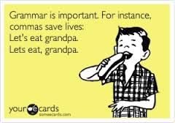

Slide 34
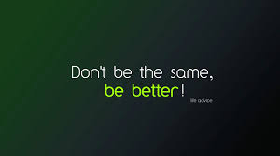
THANK YOU FOR YOUR PARTICIPATION!

